Slide 1
Chapter 6 – Architectural Design

Slide 2
Architectural patterns
An architectural pattern is a stylized description of good design practice, which has been tried and tested in different environments.
Patterns are a means of representing, sharing and reusing knowledge.

Slide 3
1- The Model-View-Controller (MVC) pattern
Separates presentation and interaction from the system data. The system is structured into three logical components that interact with each other.
The Model component manages the system data and associated operations on that data.
The View component defines and manages how the data is presented to the user.
The Controller component manages user interaction (e.g., key presses, mouse clicks, etc.) and passes these interactions to the View and the Model.

Slide 4
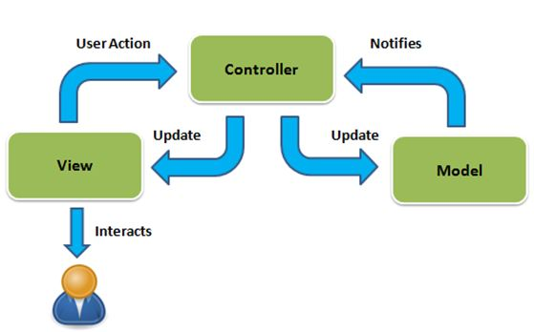
The organization of the Model-View-Controller

Slide 5
The Model-View-Controller (MVC) pattern
When used? Used when there are multiple ways to view and interact with data. Also used when the future requirements for interaction and presentation of data are unknown.
Advantages: Allows the data to change independently of its representation and vice versa. Supports presentation of the same data in different ways with changes made in one representation shown in all of them.
Disadvantages: Can involve additional code and code complexity when the data model and interactions are simple.

Slide 6
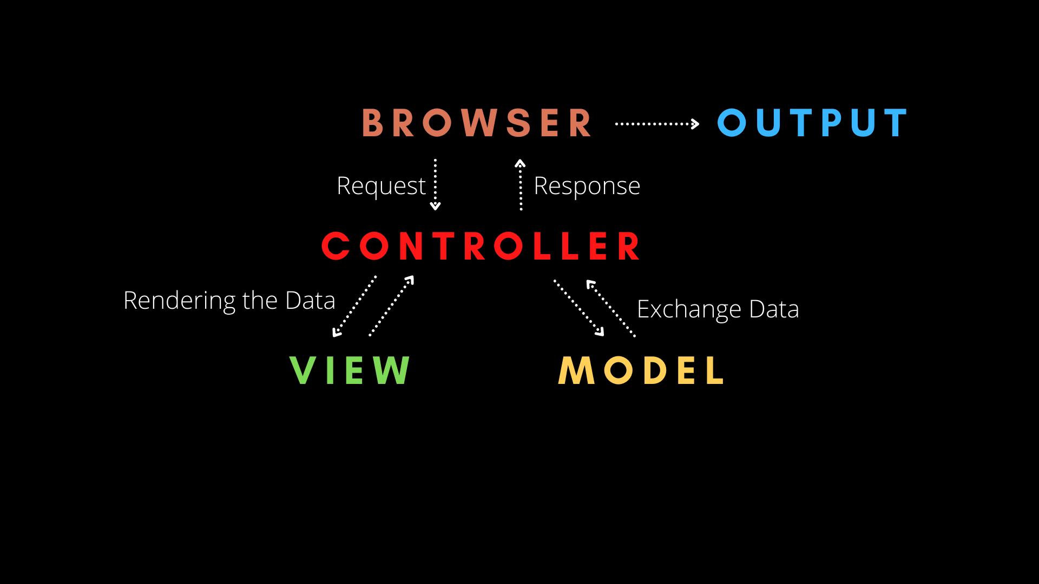
Web application architecture using the MVC pattern
Figure shows the architecture of a web-based application system organized using the MVC pattern.

Slide 7
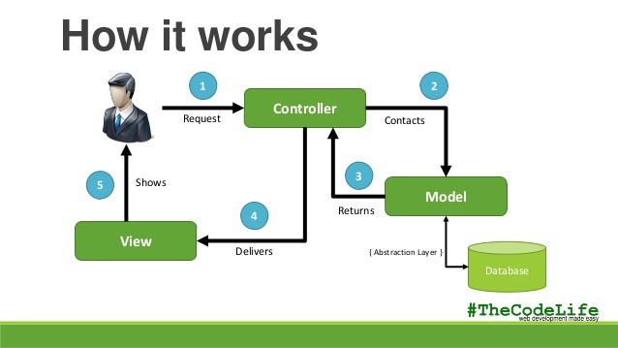

Slide 8
2- Layered architecture
Organises the system into a set of layers (or abstract machines) each of which provide a set of services.
A layer provides services to the layer above it so the lowest-level layers represent core services that are likely to be used throughout the system.
Supports the incremental development of sub-systems in different layers. When a layer interface changes, only the adjacent layer is affected.

Slide 9
A generic layered architecture

Slide 10
The architecture of the iLearn system

Slide 11
3- Repository architecture
Sub-systems must exchange data. This may be done in two ways:
Shared data is held in a central database or repository and may be accessed by all sub-systems;
Each sub-system maintains its own database and passes data explicitly to other sub-systems.
When large amounts of data are to be shared, the repository model of sharing is most commonly used as this is an efficient data sharing mechanism.

Slide 12
A repository architecture for an IDE

Slide 13
4- Client-server architecture
Distributed system model which shows how data and processing is distributed across a range of components.
Can also be implemented on a single computer.
Set of stand-alone servers which provide specific services such as printing, data management, etc.
Set of clients which call on these services.
Network which allows clients to access servers.

Slide 14
The Client–server pattern
In a client–server architecture, the functionality of the system is organized into services, with each service delivered from a separate server. Clients are users of these services and access servers to make use of them.
Used when data in a shared database has to be accessed from a range of locations. Because servers can be replicated, may also be used when the load on a system is variable.

Slide 15
A client–server architecture for a film library

Slide 16
5- Pipe and filter architecture
Functional transformations process their inputs to produce outputs.
May be referred to as a pipe and filter model (as in UNIX shell).
Variants of this approach are very common. When transformations are sequential, this is a batch sequential model which is extensively used in data processing systems.
Not really suitable for interactive systems.

Slide 17
The pipe and filter pattern
The processing of the data in a system is organized so that each processing component (filter) is discrete and carries out one type of data transformation. The data flows (as in a pipe) from one component to another for processing.
Commonly used in data processing applications (both batch- and transaction-based) where inputs are processed in separate stages to generate related outputs.

Slide 18
An example of the pipe and filter architecture used in a payments system

Slide 19
Application architectures

Slide 20
Application architectures
Application systems are designed to meet an organizational need.
As businesses have much in common, their application systems also tend to have a common architecture that reflects the application requirements.
A generic application architecture is an architecture for a type of software system that may be configured and adapted to create a system that meets specific requirements.

Slide 21
Use of application architectures
As a starting point for architectural design.
As a design checklist.
As a way of organising the work of the development team.
As a means of assessing components for reuse.
As a vocabulary for talking about application types.

Slide 22
Examples of application types
Data processing applications
Data driven applications that process data in batches without explicit user intervention during the processing.
Transaction processing applications
Data-centred applications that process user requests and update information in a system database.
Event processing systems
Applications where system actions depend on interpreting events from the system’s environment.
Language processing systems
Applications where the users’ intentions are specified in a formal language that is processed and interpreted by the system.

Slide 23
Application type examples
Two very widely used generic application architectures are transaction processing systems and language processing systems.
Transaction processing systems
E-commerce systems;
Reservation systems.
Language processing systems
Compilers;
Command interpreters.

Slide 24
Transaction processing systems
Process user requests for information from a database or requests to update the database.
From a user perspective a transaction is:
Any coherent sequence of operations that satisfies a goal;
For example - find the times of flights from London to Paris.
Users make asynchronous requests for service which are then processed by a transaction manager.

Slide 25
The structure of transaction processing applications

Slide 26
The software architecture of an ATM system

Slide 27
Information systems architecture
Information systems have a generic architecture that can be organized as a layered architecture.
These are transaction-based systems as interaction with these systems generally involves database transactions.
Layers include:
The user interface
User communications
Information retrieval
System database

Slide 28
Layered information system architecture

Slide 29
The architecture of the Mentcare system

Slide 30
Web-based information systems
Information and resource management systems are now usually web-based systems where the user interfaces are implemented using a web browser.
For example, e-commerce systems are Internet-based resource management systems that accept electronic orders for goods or services and then arrange delivery of these goods or services to the customer.
In an e-commerce system, the application-specific layer includes additional functionality supporting a ‘shopping cart’ in which users can place a number of items in separate transactions, then pay for them all together in a single transaction.

Slide 31
Server implementation
These systems are often implemented as multi-tier client server/architectures.
The web server is responsible for all user communications, with the user interface implemented using a web browser;
The application server is responsible for implementing application-specific logic as well as information storage and retrieval requests;
The database server moves information to and from the database and handles transaction management.

Slide 32
Language processing systems
Accept a natural or artificial language as input and generate some other representation of that language.
May include an interpreter to act on the instructions in the language that is being processed.
Used in situations where the easiest way to solve a problem is to describe an algorithm or describe the system data
Meta-case tools process tool descriptions, method rules, etc and generate tools.

Slide 33
The architecture of a language processing system

Slide 34
Compiler components
A lexical analyzer, which takes input language tokens and converts them to an internal form.
A symbol table, which holds information about the names of entities (variables, class names, object names, etc.) used in the text that is being translated.
A syntax analyzer, which checks the syntax of the language being translated.
A syntax tree, which is an internal structure representing the program being compiled.

Slide 35
Compiler components
A semantic analyzer that uses information from the syntax tree and the symbol table to check the semantic correctness of the input language text.
A code generator that ‘walks’ the syntax tree and generates abstract machine code.

Slide 36
A repository architecture for a language processing system

Slide 37
A pipe and filter compiler architecture

Slide 38
Key points
A software architecture is a description of how a software system is organized.
Architectural design decisions include decisions on the type of application, the distribution of the system, the architectural styles to be used.
Architectures may be documented from several different perspectives or views such as a conceptual view, a logical view, a process view, and a development view.
Architectural patterns are a means of reusing knowledge about generic system architectures. They describe the architecture, explain when it may be used and describe its advantages and disadvantages.

